Slide 1

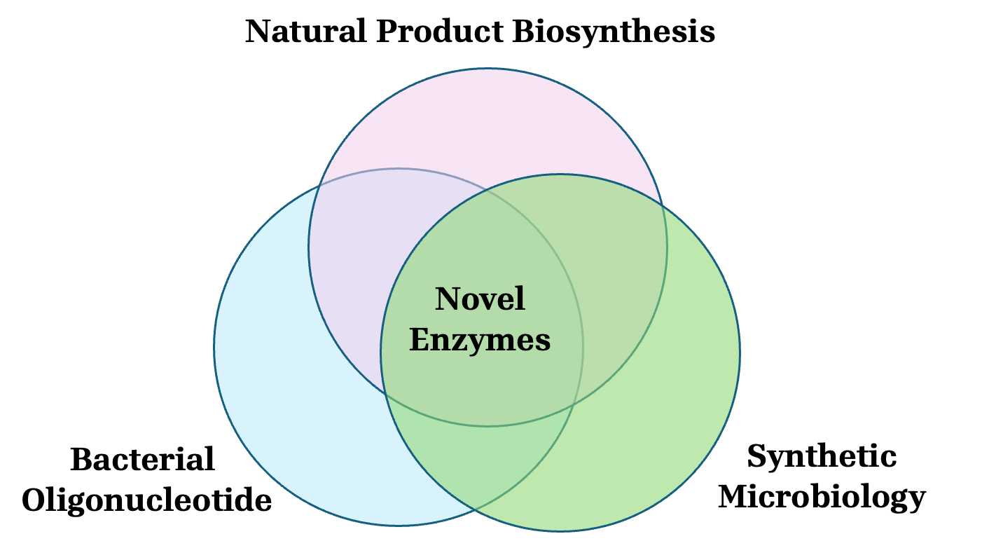
The research laboratory of Zhao-Xun Liang @ SBS, NTU
Homepage
Research
Publications
Lab members
Alumni
Gallery
Job opening and contact

Slide 2
Research
My laboratory investigates the enzymology, chemical logic, and molecular mechanisms that underpin natural product biosynthesis and bacterial pathogenesis. We seek to identify previously uncharacterized enzymes and pathways, define how they function at the molecular level, and use these insights to create new chemical and biological functionalities. Our research program integrates discovery-driven enzymology with pathway engineering and synthetic microbiology, and currently spans three interconnected areas:
Biosynthesis of natural products - Microbial specialized metabolites exhibit remarkable structural complexity and diverse bioactivities, making them a rich source of pharmaceuticals and chemical probes. The assembly of these molecules depends on highly coordinated biosynthetic enzymes that construct core scaffolds and introduce precise tailoring modifications. Advances in genome sequencing have revealed that many microorganisms encode far more biosynthetic capacity than is reflected in their known metabolites. In particular, numerous cryptic or silent biosynthetic gene clusters (BGCs) remain uncharacterized. These hidden pathways represent a substantial reservoir of unexplored enzymatic chemistry. In our lab, we maintain a collection of unique microbial strains. We sequence and mine their genomes to identify cryptic BGCs, followed by functional characterization using chemical, biochemical, and genetic approaches. By activating and reconstructing these pathways, we uncover new scaffold-forming and tailoring enzymes, define their catalytic mechanisms, and expand the known repertoire of enzymatic transformations in nature.
Design of artificial biosynthetic pathways - Many clinically important drugs are derived from natural product scaffolds that have been chemically modified to improve potency or pharmacokinetic properties. Recent advances in DNA synthesis, genome editing, and pathway engineering now allow us to redesign biosynthesis at the genetic level. We are developing strategies to engineer or create biosynthetic pathways to generate natural product derivatives and entirely new (“non-natural”) chemical scaffolds. This approach involves modular recombination of biosynthetic gene clusters, as well as enzymatic or non-enzymatic coupling of pathway intermediates. By merging distinct biosynthetic logics, we aim to create artificial pathways that expand the chemical space. Ultimately, this work seeks to harness nature’s catalytic machinery in a programmable manner, enabling the scalable production of structurally novel compounds with potential therapeutic value.
Cyclic dinucleotide–mediated bacterial pathogenesis - Cyclic dinucleotides such as c-di-GMP and c-di-AMP have emerged as central second messengers in many clinically significant pathogens. These messengers regulate diverse processes including virulence factor expression, motility, biofilm formation, and stress responses. Accumulating evidence indicates that cyclic dinucleotide signaling is governed by complex networks of synthases, phosphodiesterases, receptors, and effector proteins. These components operate in a tightly controlled spatiotemporal network, allowing bacteria to dynamically adapt to host environments. Our research aims to identify previously uncharacterized enzymes and effector proteins involved in cyclic dinucleotide signaling and to elucidate their mechanistic roles in infection and antibiotic resistance. By dissecting these regulatory circuits at the molecular level, we seek to reveal new vulnerabilities in pathogenic bacteria. This work has the potential to inform the development of next-generation antimicrobial strategies, including inhibitors targeting signaling proteins and approaches to disrupt biofilm formation.

Slide 3
Publications
Publications are attached in a separate file

Slide 4
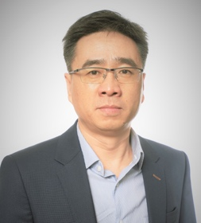


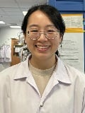
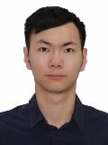




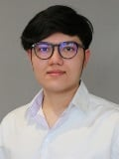

Lab members
Principal investigator
Zhao-Xun Liang
Wang Xuejiao Research Fellow | Hartono Candra Research Fellow | Tan Swee Ching Research Assistant | Liao Yanghui PhD Student
Huang Huawei PhD Student | Srashti Khandelwal PhD Student | You Jiaqi PhD Student | Chang Shu Ting Research Assistant
Sirus Kongjaroon Research Assistant | Sun Yunke PhD Student

Slide 5
Alumni
PhD and MS student | Year | Dissertation title | Current position
Rao Feng | 2007-2011 | Catalysis and regulation of cyclic dinucleotide phosphodiesterases | Professor, Science & Technology University of South China
Qi Yaning | 2007 - 2011 | Structure and function of GGDEF-EAL didomain proteins in c-di-GMP signaling | University of Macau
Kong Rong | 2007 - 2011 | Structure and function of proteins in the early stage of enediyne biosynthesis | Procter & Gamble Corporation, Singapore
Ela Murugan | 2008 - 2012 | Iterative polyketide synthase in enediyne biosynthesis | Director, PrEI’s Technologies Pte Ltd
Sun Huihua | 2008 - 2012 | A study on the iterative type I polyketide synthesis in enediyne and mellein biosynthesis | Shanghai, China
Lawrence Ho Chun Long | 2009-2013 | Design and application of cyclic di-GMP fluorescent biosensors | Associate Professor, Shenzhen Advanced SynBiol Institute
Liew Chong Wai | 2009-2013 | Structural studies of enzymes from enediyne biosynthetic pathways | A*STAR, Singapore
Chen Ming Wei | 2009-2013 | Structural studies of enzymes regulating life style and cell wall biogenesis | School of biological Sciences, NTU
Mary Chuah | 2010-2014 | Cyclic di-GMP signaling in Bacillus subtilis | United Kindom
Alolika Cakrabortti | 2012-2016 | Genomics-guided approaches to discovery of microbial secondary metabolites | Research scientist, Lonza Group Ltd, Singapore
Prabhadevi Venkataramani | 2012-2016 | Regulation of two-component signaling by a c-di-GMP-binding PilZ adaptor | Research fellow, National Institute of Health, USA
Cheang Qing Wei | 2013-2017 | Cyclic di-GMP signaling through PilZ adaptor proteins | Scientist, ThermoFiisher, Singapore
Pang Li Mei | 2014-2018 | Bioprospecting local actinomycetes for natural product discovery | A*STAR, Singapore
Low Zhen Jie | 2014-2018 | Natural product biosynthesis and discovery in actinomycetes | Research scientist @ Waters Inc. Singapore
Xin Ling Yi | 2014-2018 | MapZ-mediated c-di-GMP signaling in Pseudomonas aeruginosa | Tianjin, China
Hartono Candra | 2018 - 2022 | Genome-guided discovery of microbial natural products | Research fellow, NTU
Sean Lee | 2020-2024 | Heterologous expression of biosynthetic pathways in Streptomyces hosts | Singapore Botanical Garden
Jamila Oppong (MS) | 2013 - 2014 | Molecular mechanism of cyclic di-GMP signaling | Ph.D. student, Manchester University, UK.
Daryn Tan Fu Ern (MS) | 2018 - 2019 | Genome-guided natural product discovery from a Streptomyces strain | Secondary school teacher, Singapore
Rachel Chua (MS) | 2018-2020 | Development of Streptomyces sp. MD102 a heterologous host | Research staff, NUS
PhD and MS student | Year | Research project | Current position
Chong Zhi Soon | 2018 - 2020 | Genome-guided discovery of natural products | NUS
Howard Saw | 2017-2019 | Genome-guided discovery of microbial natural products | Singapore
Yang Lifeng | 2012-2014 | Engineering of nitrile reductase | Singapore
Xu Linghui | 2010 – 2014 | PilZ protein-mediated bacterial signaling | Professor, Southern China Agricultural University
Wu Long | Aug 2011-Dec 2011 | Bacterial signaling mediated by cyclic di-AMP | Xi’an, China
Ma Guang-Lei | 2018 - 2023 | Heterologous expression of cannabinoid biosynthetic pathway | Associate professor, Zhejiang University, China

Slide 6
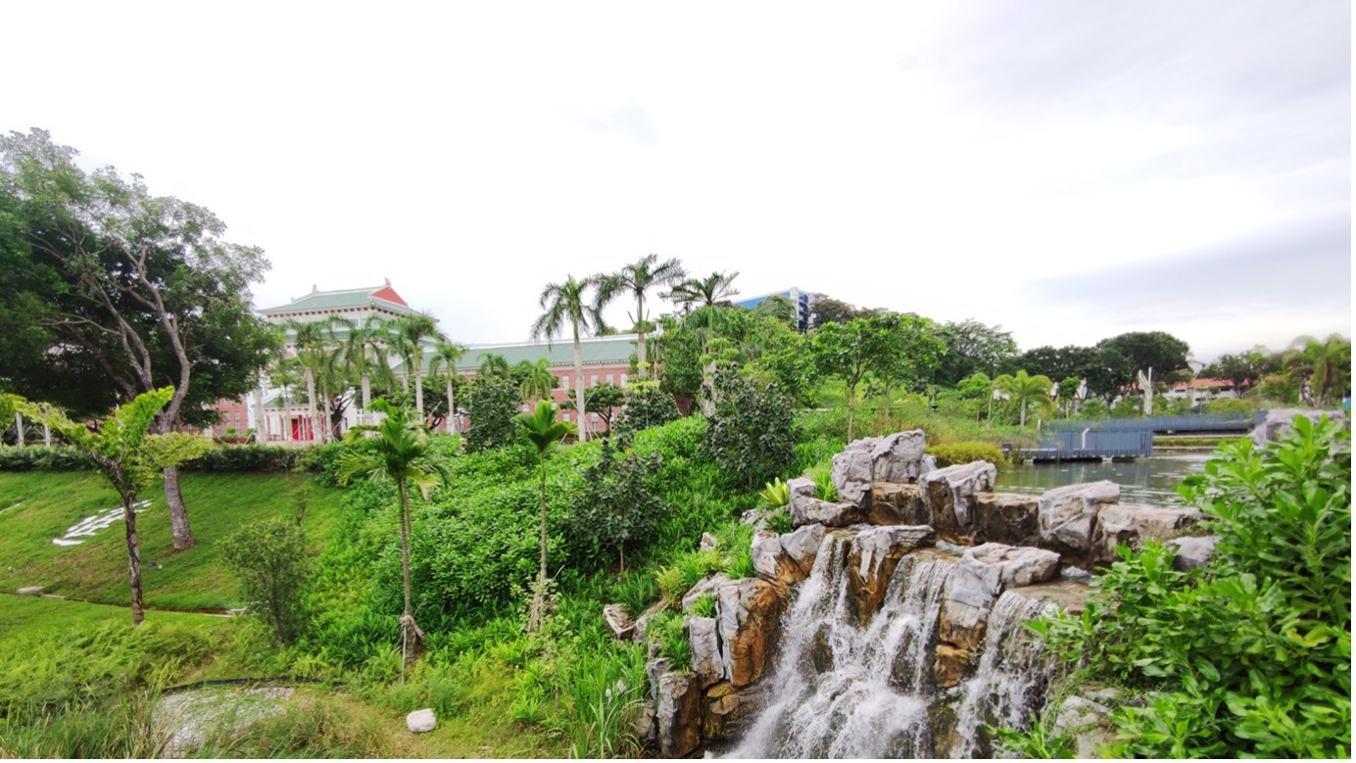
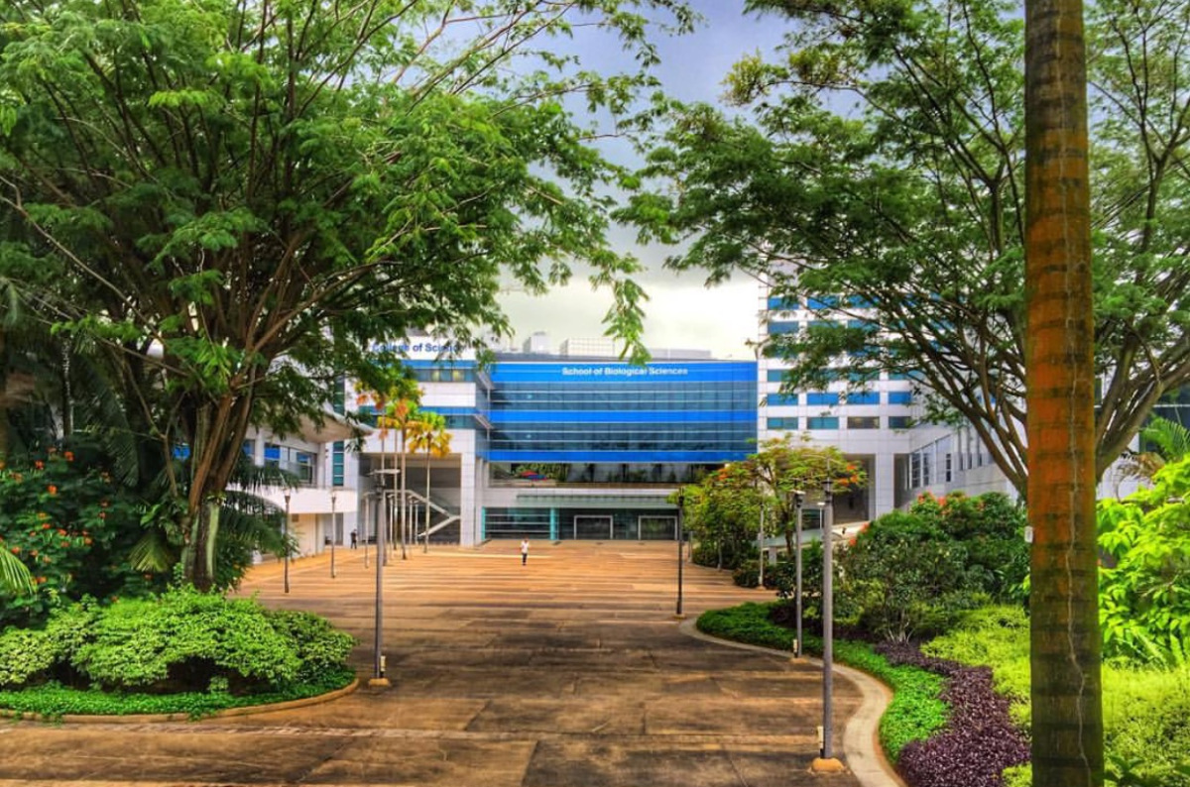
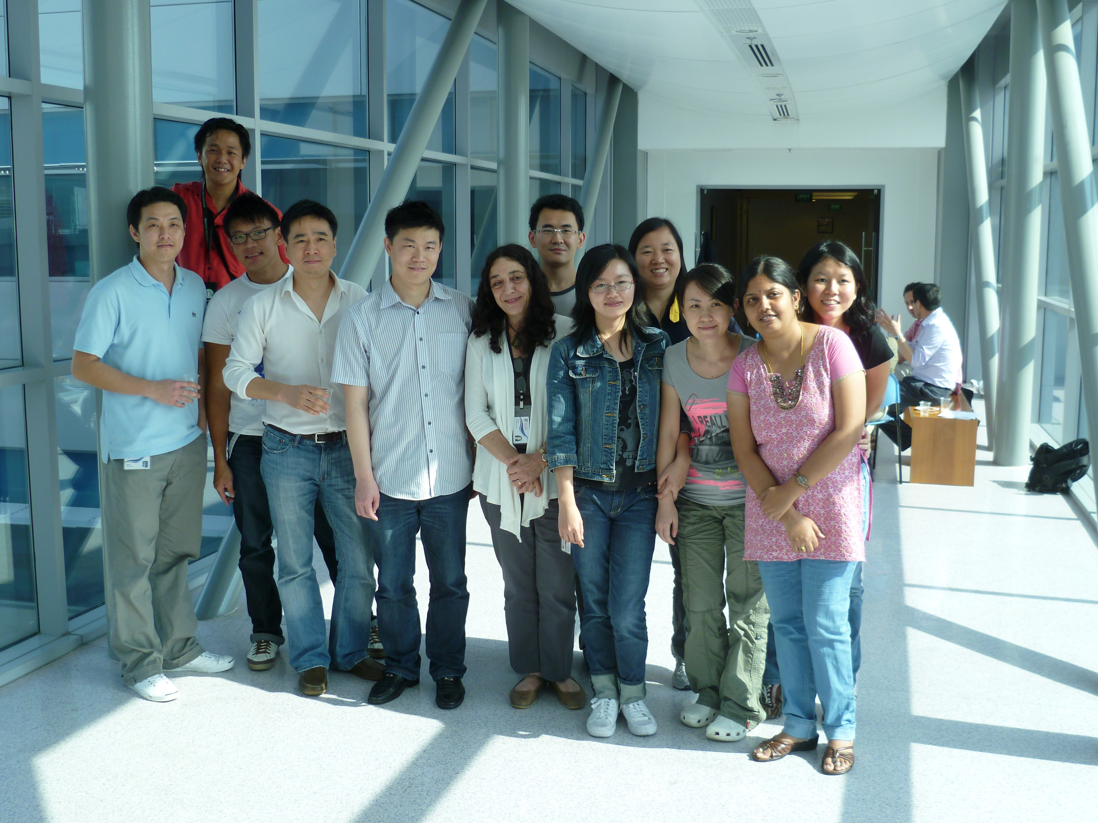
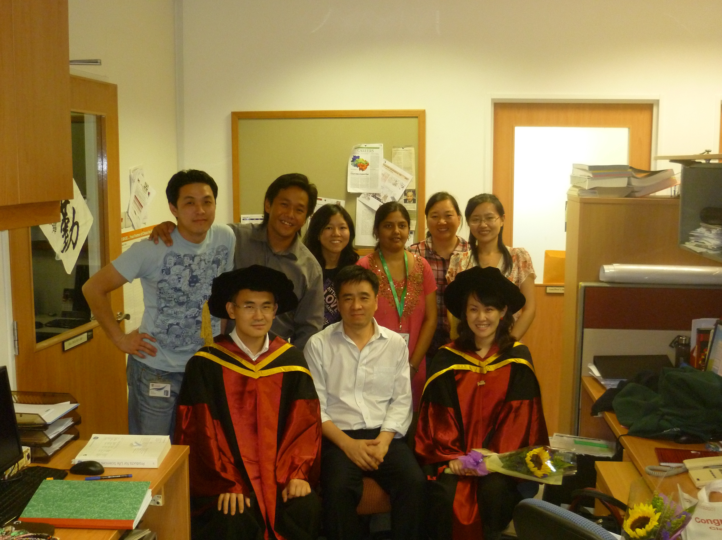
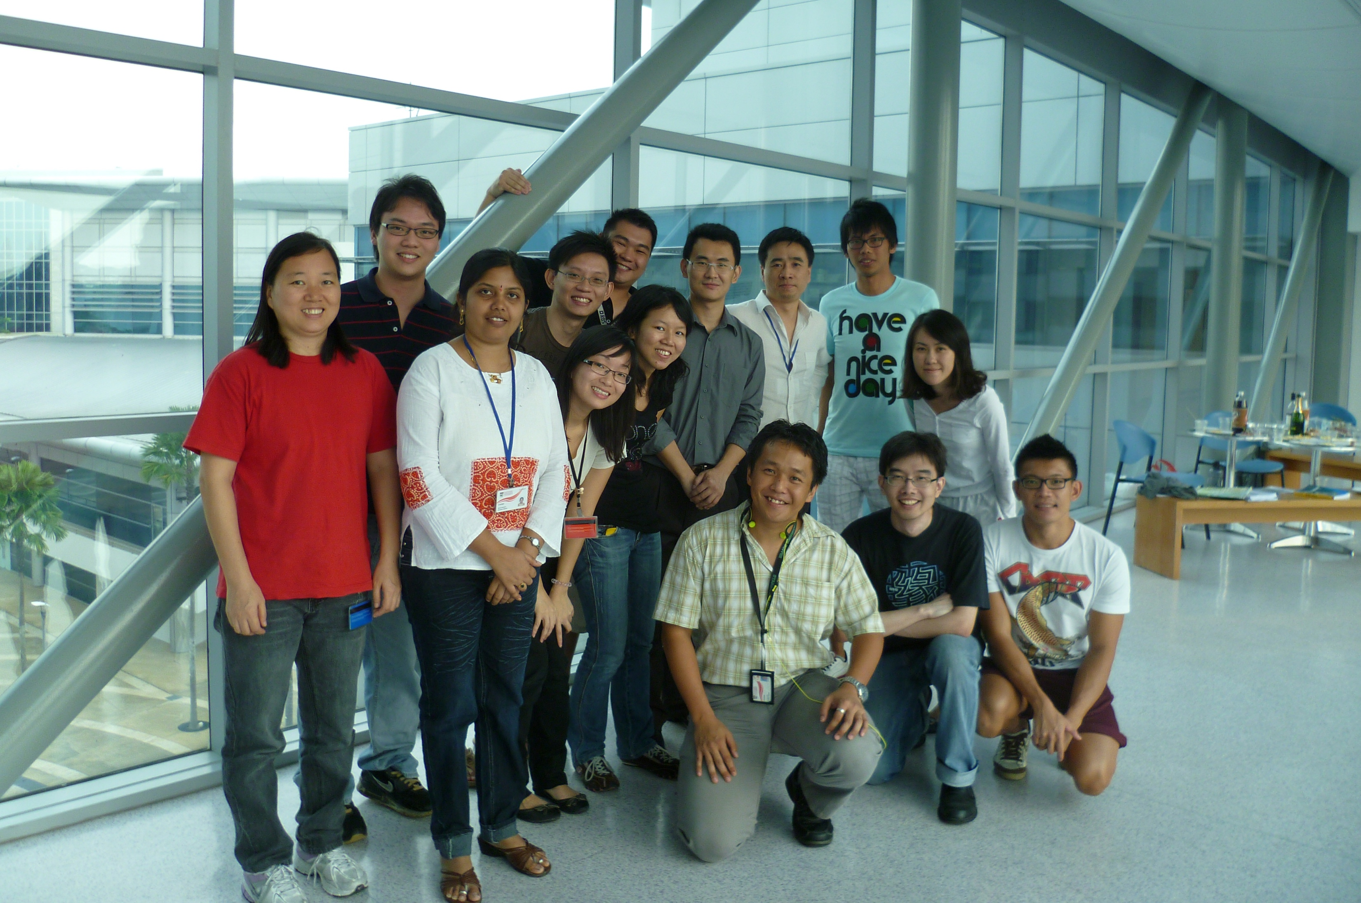
Gallery
NTU campus
SBS building
2011 Group photo
2011 Convocation
2012 Group photo

Slide 7
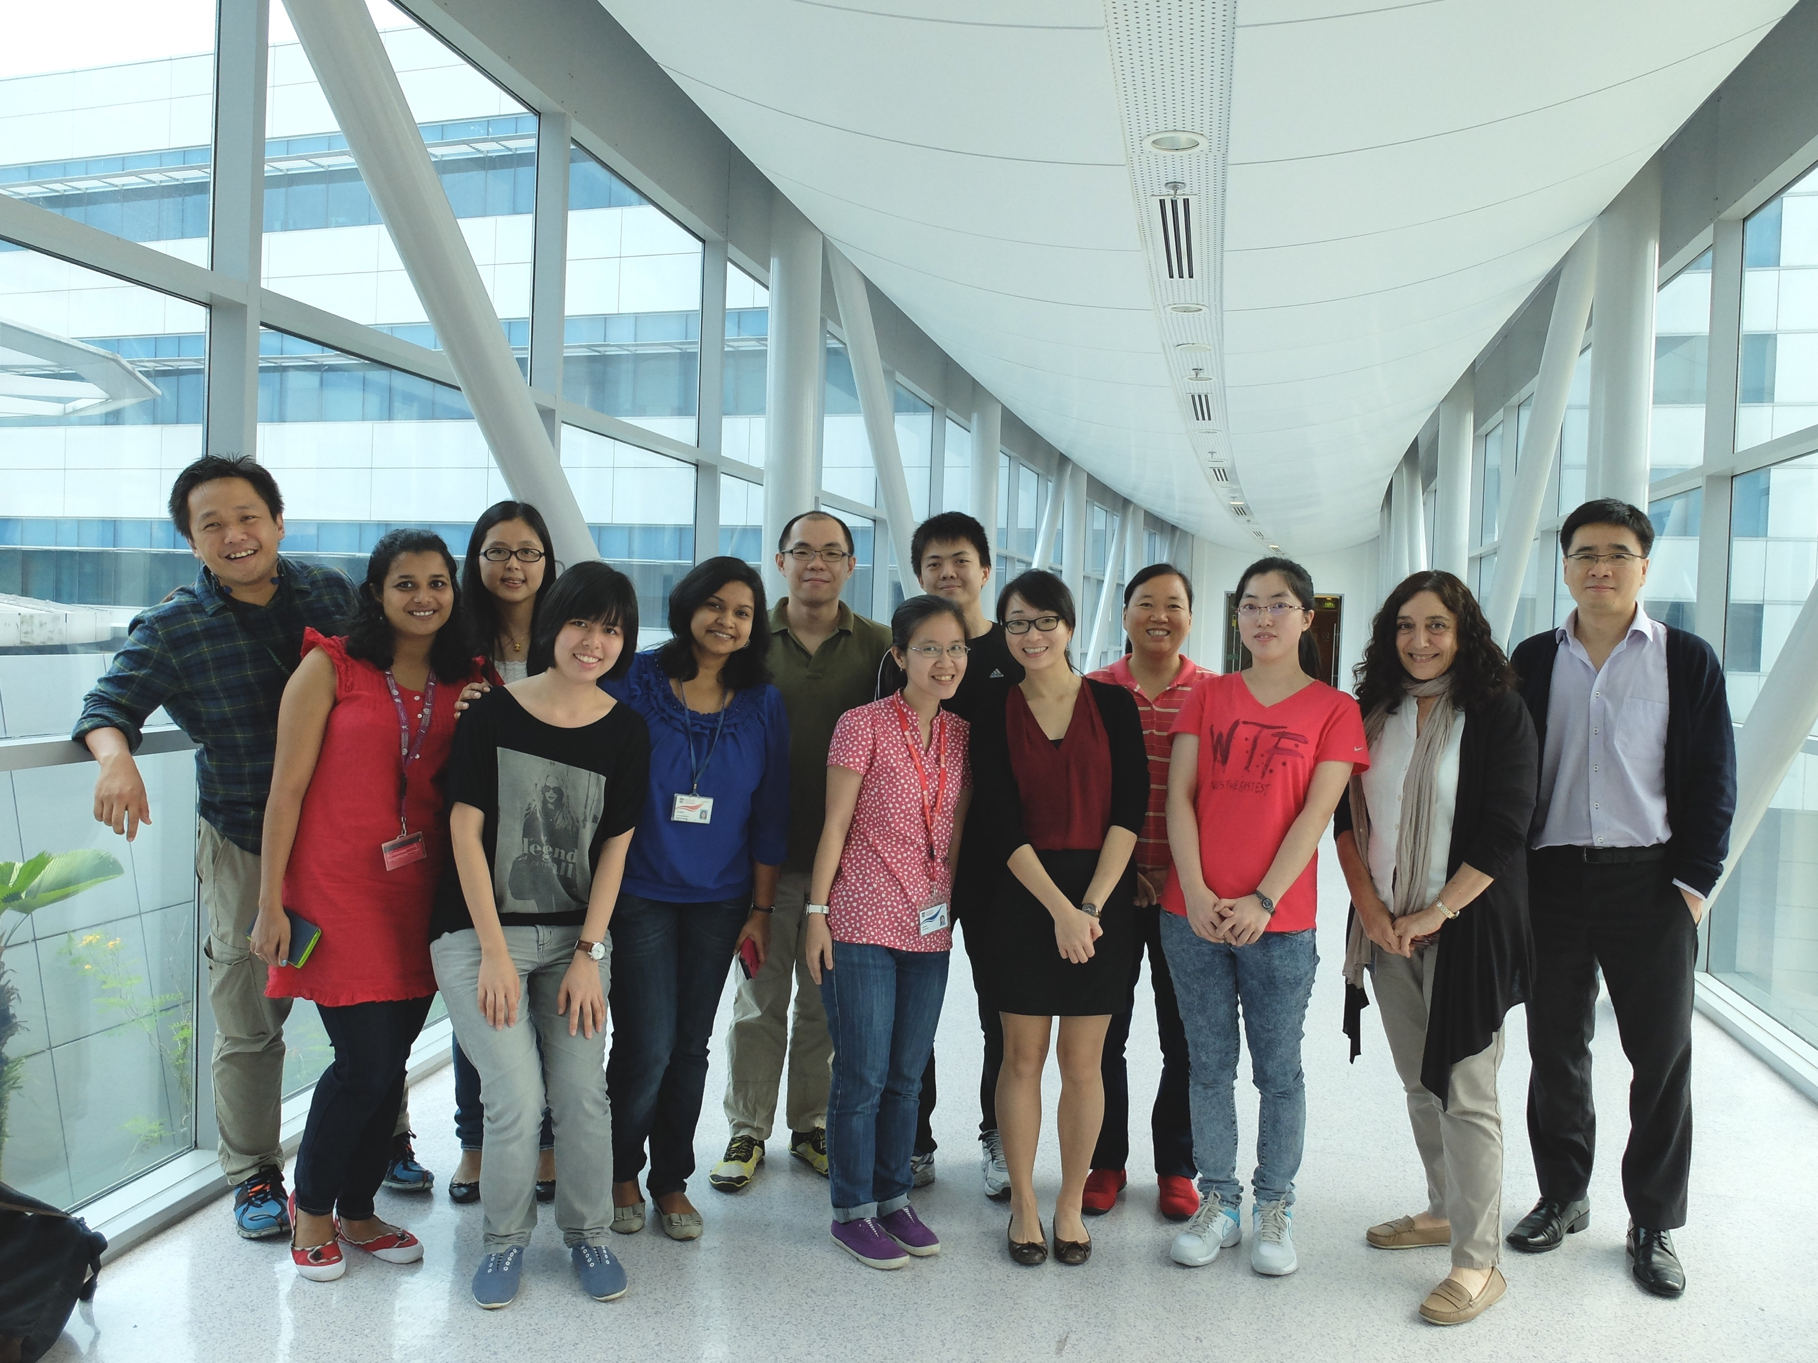
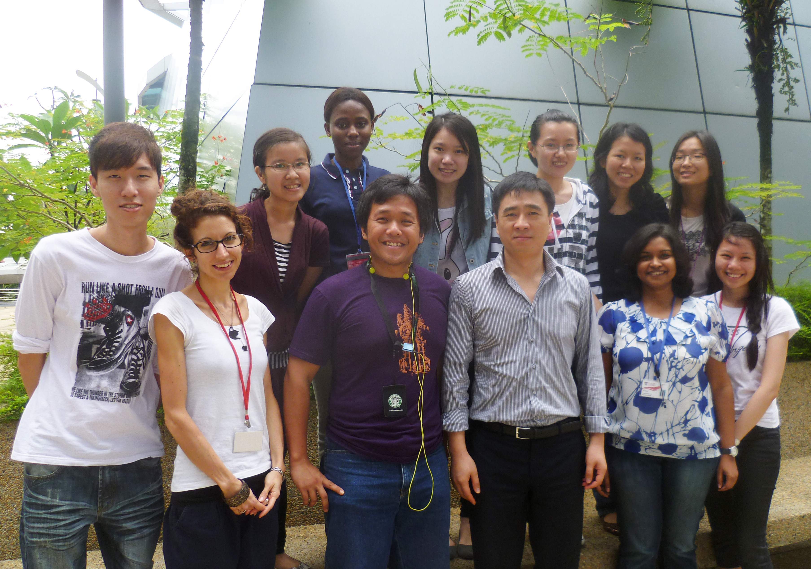
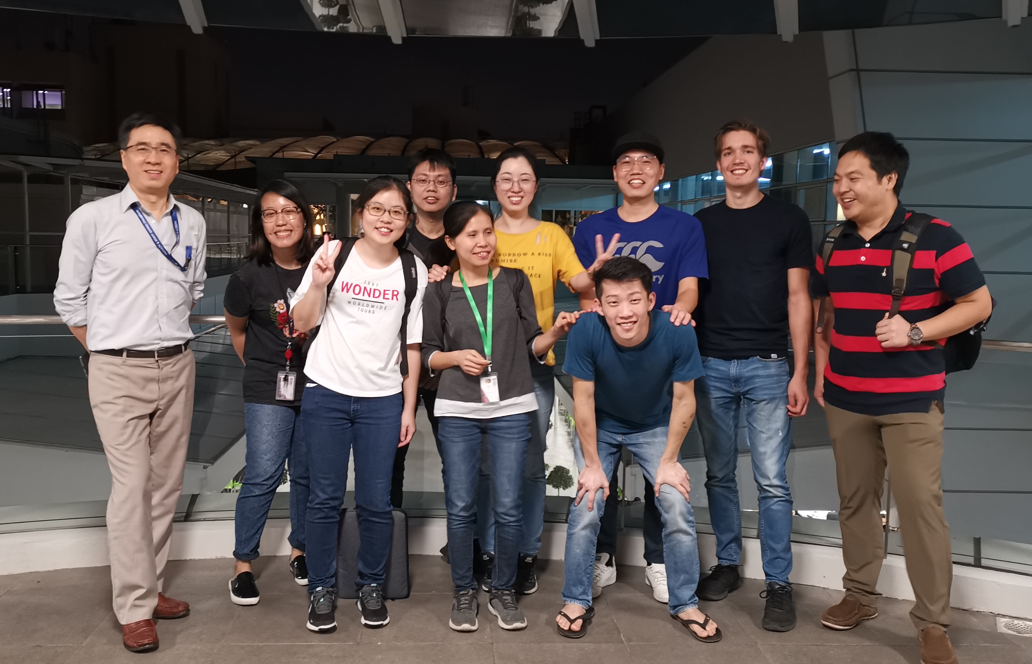
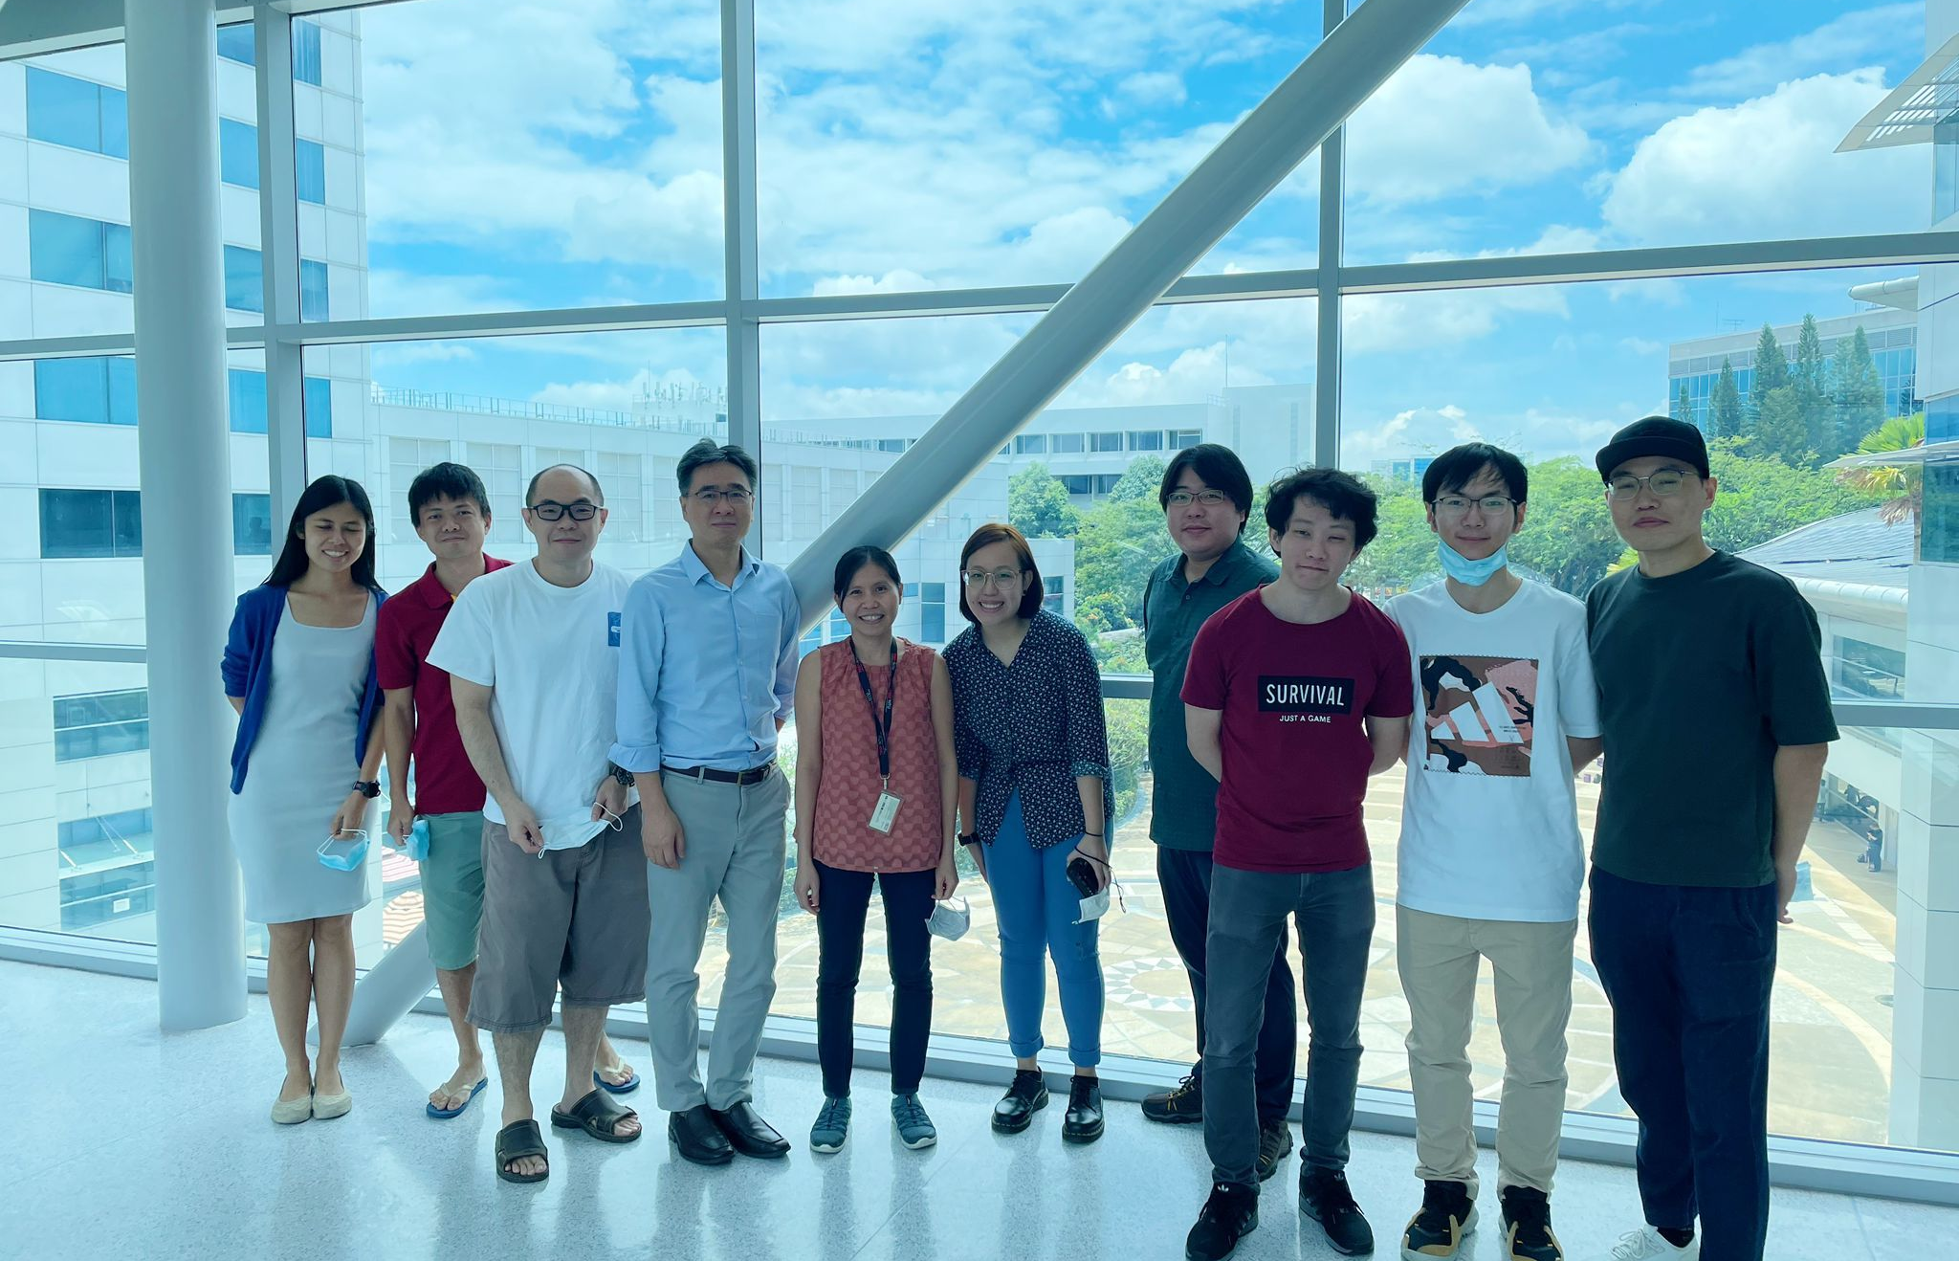
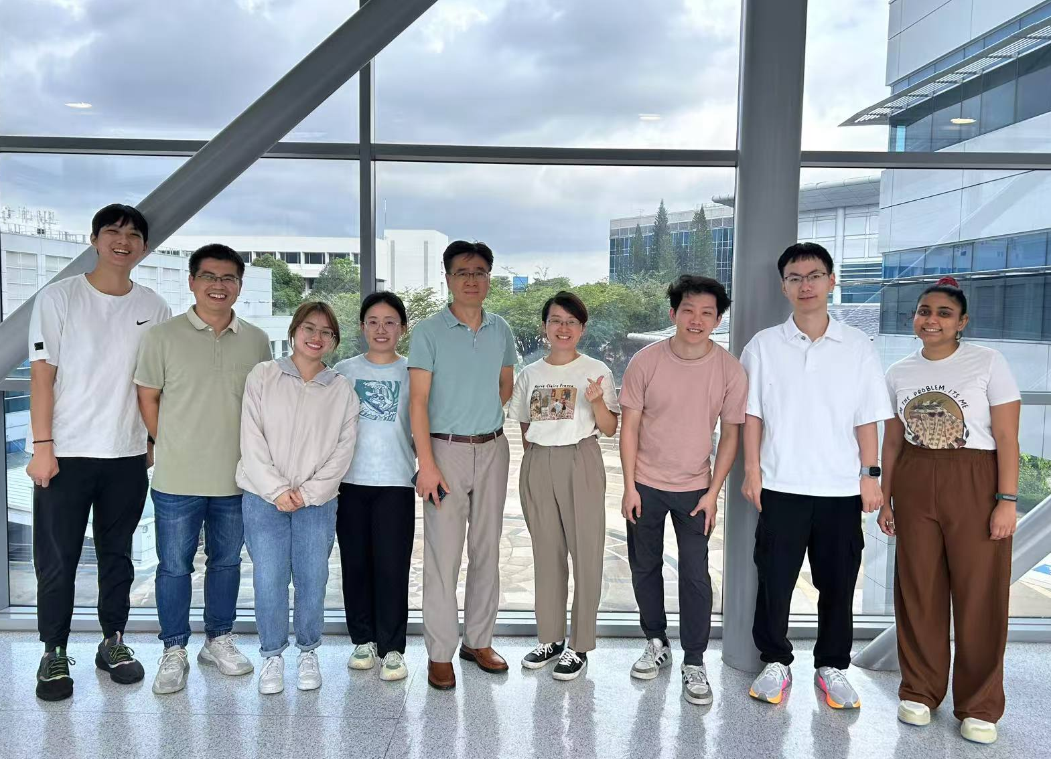
2014 Group photo
2015 Group photo
2018 Group photo
2021 Group photo
2023 Group photo

Slide 8
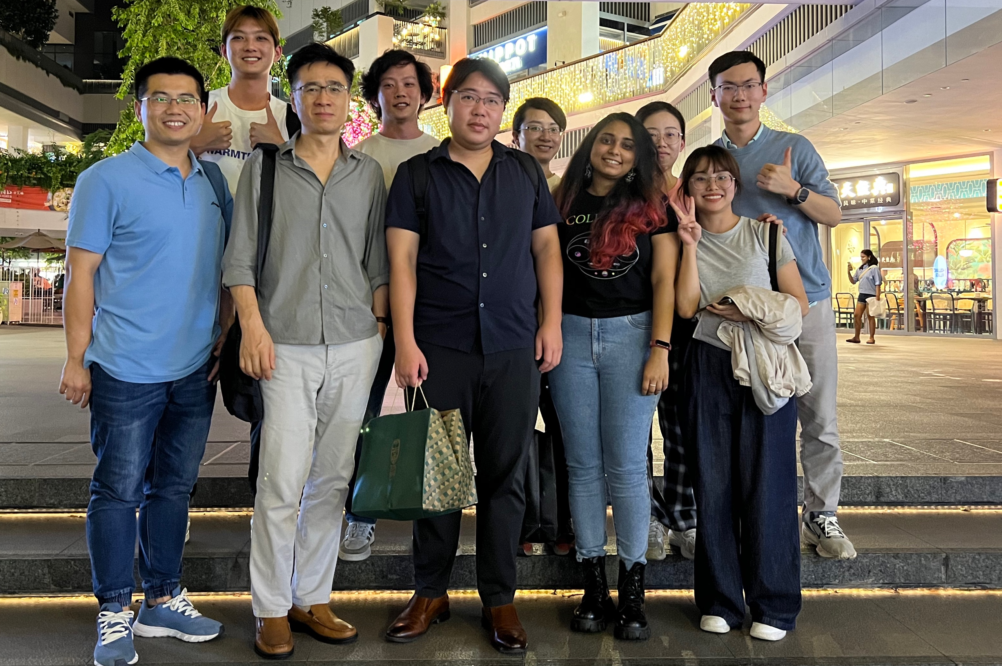
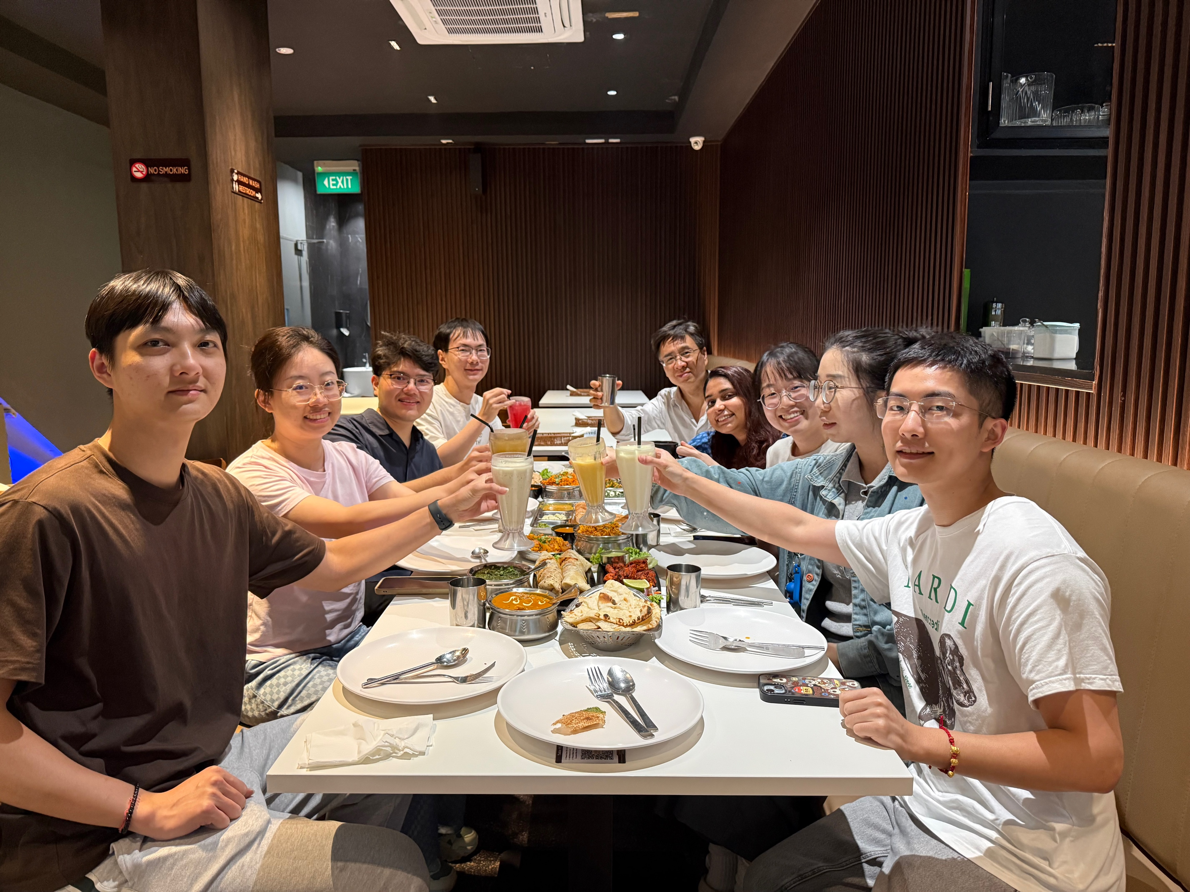
2024 Group photo
2025 Group photo

Slide 9
Contact
Zhao-Xun Liang
School of Biological Sciences
60 Nanyang Drive
Nanyang Technological University
Singapore, 637551
Tel: 6592 7736
Fax: 6791 3856
Email: zxliang@ntu.edu.sg
Web: https://dr.ntu.edu.sg/cris/rp/rp00358
Job opening
For inquiries regarding postdoctoral fellow, research assistant, or PhD student positions, please email zxliang@ntu.edu.sg

